Slide 1

Weather-verse
Name – Paras Jha
Micro IT Project

Slide 2

Introduction
WeatherVerse is an intelligent weather forecasting web application that provides real-time weather updates, 3-day forecasts, and personalized weather insights based on your location. Whether you're planning a trip, heading to work, or just curious about the skies — WeatherVerse helps you stay one step ahead of the weather.

Slide 3
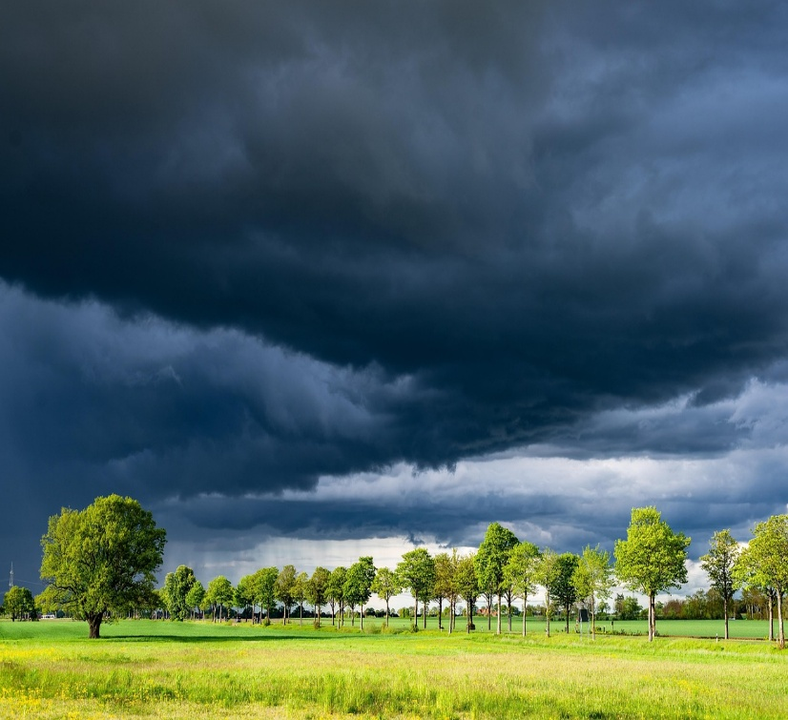
Objectives of the project
1.Provide Accurate and Real-Time Weather Information
Users get up-to-date weather conditions to plan their day better.
2.Offer Multi-Day Forecasts
Display 3-day weather forecasts to help users prepare in advance.
3.Enable Location-Based Weather Updates
Support automatic location detection for personalized weather info.
4.Enhance User Experience with Dynamic UI
Use weather-themed backgrounds, dark mode, and intuitive controls.
5.Support Easy Access and Usability
Include features like search history and temperature unit toggle for convenience.
6.Make Weather Information Accessible Anytime, Anywhere
Design a responsive web app usable on desktops and mobiles.

Slide 4
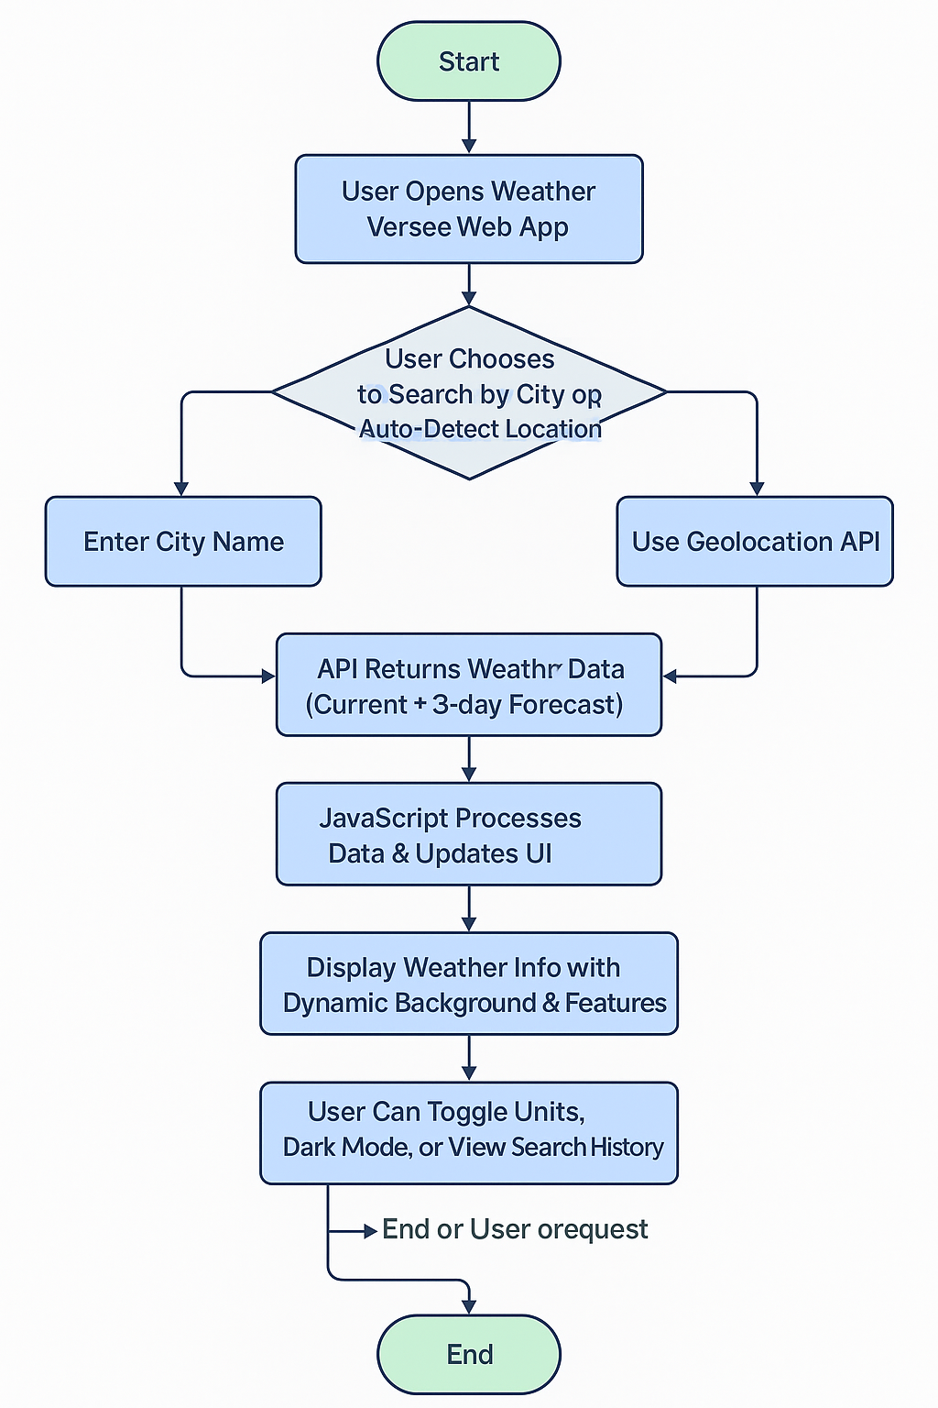
🛠️ TECHNOLOGIES USED in weather-verse
HTML For structuring the web pages and content layout.
CSS For styling, responsive design, and creating dynamic weather-themed visuals.
JavaScript To fetch real-time weather data, handle user interactions, and update the UI dynamically.

Slide 5
Future scope of weather verse
Immersive Weather Visualization Real-time 3D AR/VR weather experiences for education & planning.
Hyperlocal Real-Time Data IoT sensors provide precise weather info for neighborhoods & farms.
AI-Powered Forecasting Enhanced accuracy & early warnings using machine learning.
Smart City Integration Weather-driven traffic, energy, and emergency management.
Social & Gamified Platform Community reporting, challenges, and citizen science.
Personalized Health Alerts Weather-based lifestyle and allergy recommendations.

Slide 6
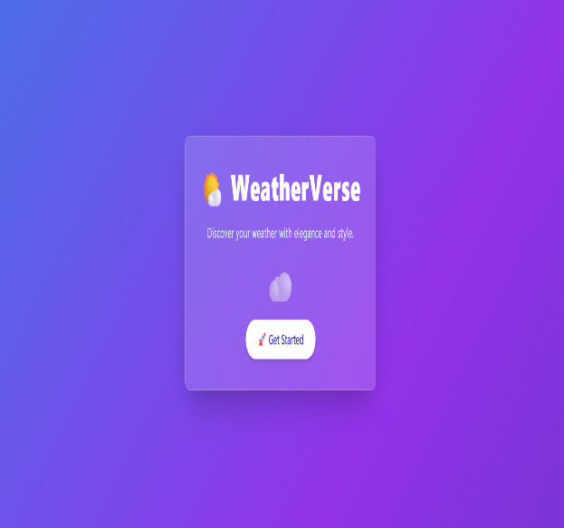
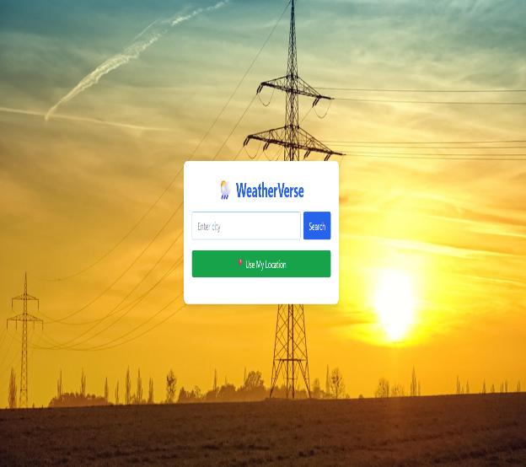
User-interface of weather-verse
Dashboard: Real-time weather, location search, animated background.
3D Interactive Map: AR/VR globe view with live weather layers.
Personalized Feed: Weather-based tips, alerts, and user reports.
Alert Panel: Instant disaster warnings and safety tips.
Education Zone: Climate change visuals and interactive learning.

Slide 7
Conclusion
Weather Verse revolutionizes how we experience and interact with weather.
Combines real-time data, AI, AR/VR, and IoT for immersive and personalized insights.
Enhances safety, awareness, and decision-making across everyday life, agriculture, smart cities, and climate education.
A step toward a more connected, informed, and resilient future.

Slide 8


